Slide 2
CHAPTER 24
The Role of Architects in Projects

Slide 3
I don’t know why people hire architects and then tell them what to do.
—Frank Gehry

Slide 4
Chapter Outline
Introduction
The Architect and the Project Manager
Incremental Architecture and Stakeholders
Architecture and Agile Development
Architecture and Distributed Development
Summary

Slide 5
Introduction
In this chapter, we deal with the aspects of architecture and the architect’s responsibilities that derive from the realities of development projects.
We begin by discussing a key project role with whom you as an architect are likely to have a close working relationship: the project manager.

Slide 6
The Architect and the Project Manager
The project manager is responsible for the overall performance of the project, typically for keeping it on budget, on schedule, and staffed with the right people doing the right jobs.
The project manager handles the external-facing aspects of a project, while the architect focuses on the internal technical work.
The external view needs to accurately reflect the internal situation, and the internal activities need to accurately reflect the expectations of the external stakeholders.
Successful projects require tight coordination between the external-facing work of the project manager and the internal work of the architect.

Slide 7
Incremental Architecture and Stakeholders
Agile methodologies are based on incremental development, with each increment delivering value to the customer or user.
Even if your project is not an Agile one, you should still expect to develop and release your architecture in increments following a tempo that supports the project’s own test and release schedule.
Incremental architecture, then, is about releasing the architecture in increments. Specifically, this means releasing architecture documentation in increments. So, architect should decide which views to release and at which depth.

Slide 8
Incremental Architecture and Stakeholders
consider these as candidates for your first increment:
A Module decomposition structure: Helps organize the team and project by showing how the system is divided into parts. It guides team setup and budgeting.
A Module "uses" structure: Shows how different parts of the system depend on each other. This helps plan the order of development and supports releasing the system in stages.
A C&C structure: Shows the main parts of the system and how they work together. It gives a clear view of the overall solution.
A Deployment structure: Shows where the system will run, like on mobile phones or in the cloud.
After that, use the needs of the architecture’s stakeholders as a guide when crafting the contents of subsequent releases.

Slide 9
Architecture and Agile Development
Agile development began as a rebellion against development approaches that were focused on up-front planning and design.
Agile prefers to use time and resources for building what the customer actually needs, instead of spending too much on documentation, and they start doing this early in the project.
Early Agile thinking often viewed up-front architecture as a distraction from delivering working software.
The key question is this: How much up-front work, in terms of requirements analysis, risk mitigation, and architecture design, should a project undertake?
There is no universal answer, but a project's size, complexity, quality requirements, volatility, and team distribution help determine the right amount.

Slide 10
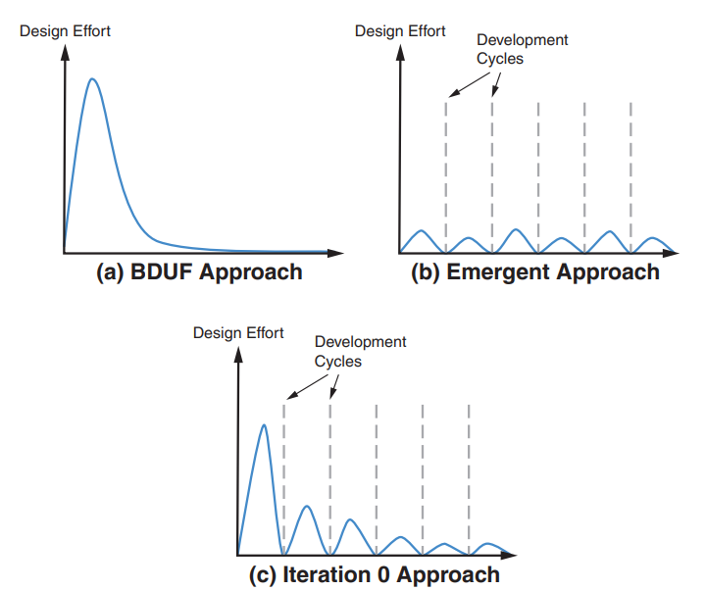
Architecture and Agile Development
You can opt for waterfall-style Big Design Up Front (BDUF) or trust in the emergent approach.
Between the extremes of BDUF and emergent architecture lies the recommended Iteration 0 approach, which balances planning and agility.

Slide 11
Architecture and Agile Development
When requirements change, you should follow an Agile practice called a "spike."
A spike is a time-boxed task to answer a technical question or gather information; it is not intended to lead to a finished product.
The Agile Manifesto of 2001, the Prime Directive of the Agile movement, implies that architecture is emergent and does not need to be planned or designed up-front.
For medium to large systems, this view has inevitably collapsed under the harsh weight of experience.
Solutions for security, high performance, safety, and many more concerns must be designed into the system’s architecture from the beginning.

Slide 12
Architecture and Agile Development
One example of an approach to apply Agile at enterprise scale is the Scaled Agile Framework (SAFe).
SAFe provides a reference model of workflows, roles, and processes to successfully produce a large-scale system.
SAFe acknowledges the role of architecture. It suggests intentional architecture.
Intentional architecture defines a set of purposeful, planned architectural strategies and initiatives.
SAFe also counsels a counterbalancing force called emergent design. But it views emergent design as complementing, not replacing intentional architecture.

Slide 13

Architecture and Distributed Development
Most big projects today are developed by distributed teams. Distributed teams may be spread across buildings, cities, time zones, or even organizations.
Distributed development comes with both benefits and challenges.
Wages are different in different places, and many believe that sending part of the work to countries with lower labor costs will automatically make the whole project cheaper.
Benefits include potential cost savings, access to broader skill sets, and better local market knowledge; however, these come with coordination and communication challenges.

Slide 14
Architecture and Distributed Development
Assume Module A uses an interface from Module B. So, the team responsible for Module B must coordinate with the team responsible for Module A.
It’s easy to coordinate when team members are in the same place and can quickly talk in person, like while getting a snack. But it’s much harder when teams are far apart and have to plan online meetings, especially if it’s nighttime for some of them.
Allocation of responsibilities to teams is more important in distributed development than in co-located development.
Attention to module dependencies takes on added importance. Dependencies among modules owned by globally distributed teams are more likely to be problematic.

Slide 15
Architecture and Distributed Development
Documentation is especially important in distributed development.
Remote teams must rely on more formal mechanisms such as documentation, and team members must take the initiative to talk to each other when doubts arise.
It seems likely to lead to distributed development becoming the norm. The shift to remote work has accelerated adoption of distributed development and may spark new architectural trends.

Slide 16
Summary
In this chapter, we discussed the architect’s responsibilities, deriving from the realities of development projects.
The project manager and the software architect have different but complementary roles. The manager runs the project from an administrative perspective, and the architect runs the project from a technical solution perspective.
In real projects, software architectures aren’t created all at once or instantly. Instead, they are developed and shared step by step, in parts that are useful to the people involved.
Agile methodologies focus on incremental development. Over time, architecture and Agile (although they got off to a rough start together) have become indispensable partners.

